Slide 1


Change Management
~ PRIYANKA D

Slide 2
What is change management?
Software systems are subject to continual change requests
From users
From developers
From market forces
Change management is concerned with keeping track of these changes and ensuring that they are implemented in the most cost-effective way.

Slide 3
What are Change requests?
Change Request: A formal proposal for an alteration to some product or system.
TYPES OF CHANGE REQUESTS
Change Advisory Board (CAB) (Enhancement)
Workorder (Perfective)
Adaptive (Adaptive)
Corrective (Corrective)

Slide 4

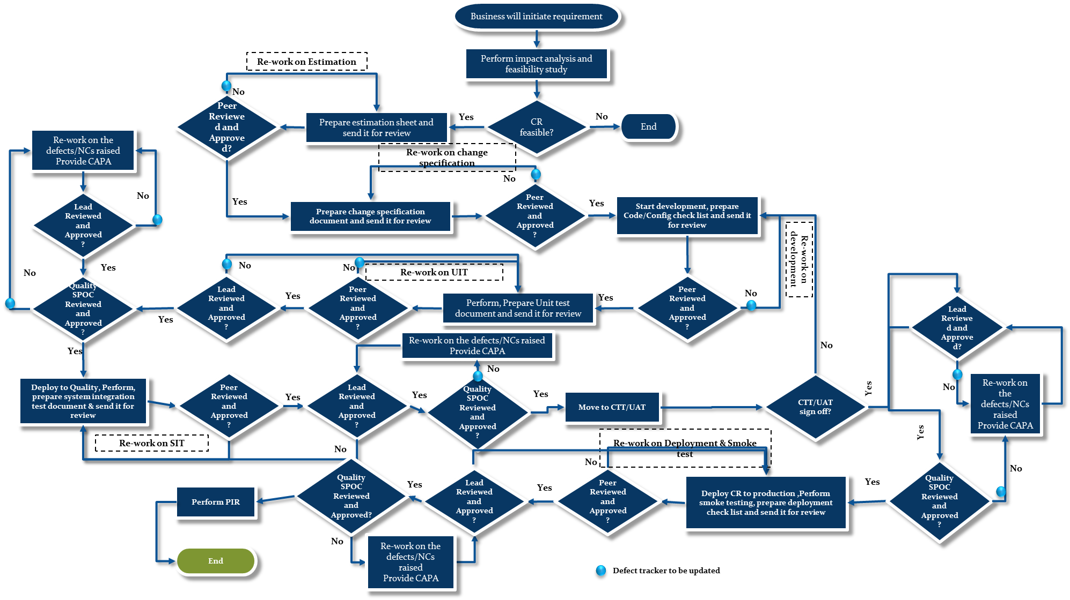
CR Cycle

Slide 5
Emergency change request
Emergency CR: A change that must be introduced as soon as possible.
E.g.: To resolve a major incident or to implement a security patch.
Approvals required:
Application manager approval
Lead Approval
PM/DM approval
Quality SPOC approval

Slide 6
Change management SLA
On Time Delivery (OTD)
First Time Right (FTR)
Post Implementation Review (PIR)

Slide 7
Thank You

